Slide 1
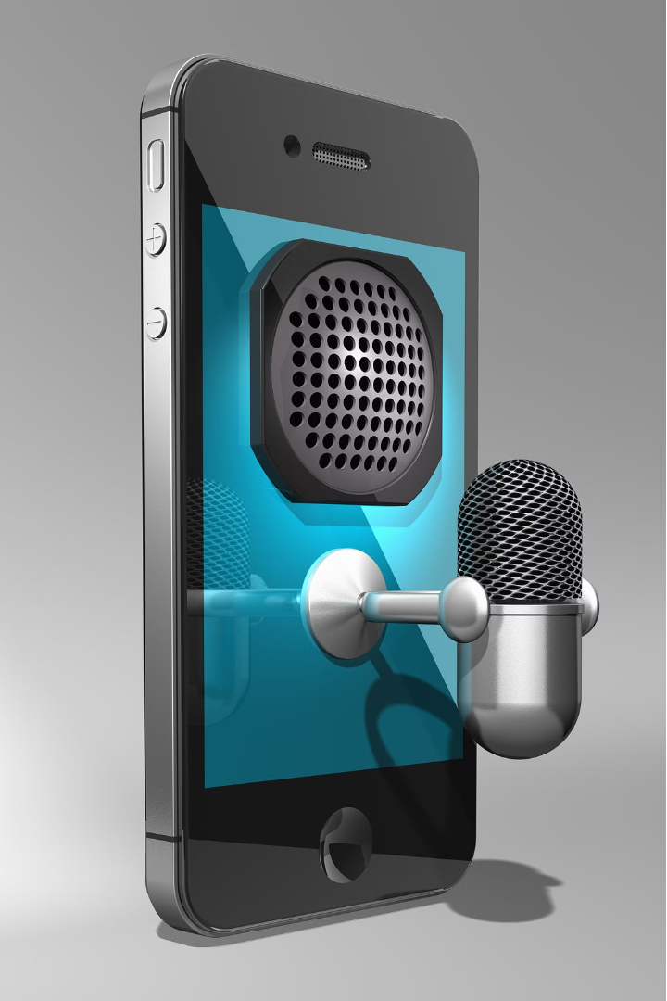



Introduction to Virtual assistant Systems
Virtual assistant technology has transformed the way we interact with our devices. It enables hands-free control and natural language processing, making our lives more efficient and convenient.

Slide 2
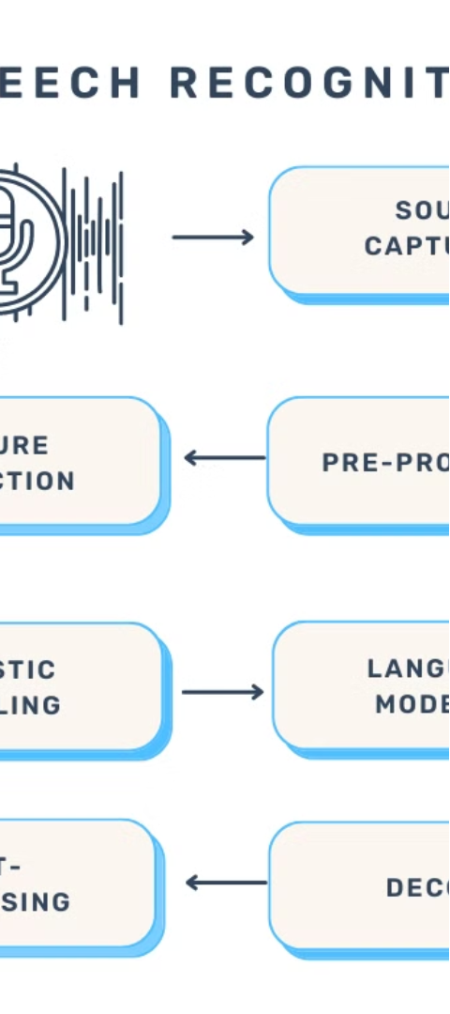

How Virtual assistant Works
1
Speech Capture
The system uses a microphone to record the user's voice input.
2
Speech Processing
The audio signal is converted to a digital format and analyzed for speech patterns.
3
Language Modeling
The system compares the input to a database of known words and phrases to determine the most likely interpretation.

Slide 3

Key Components of a Virtual assistant System
Microphone
Audio Processor
Speech Recognition Engine
Captures the user's speech input.
Converts the analog audio signal to a digital format.
Analyzes the digital audio and matches it to known speech patterns.

Slide 4
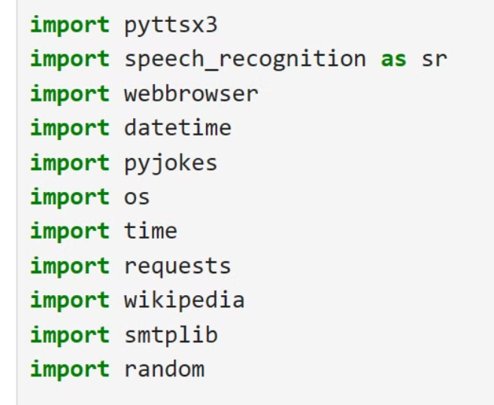

Libraries which are included in the project

Slide 5
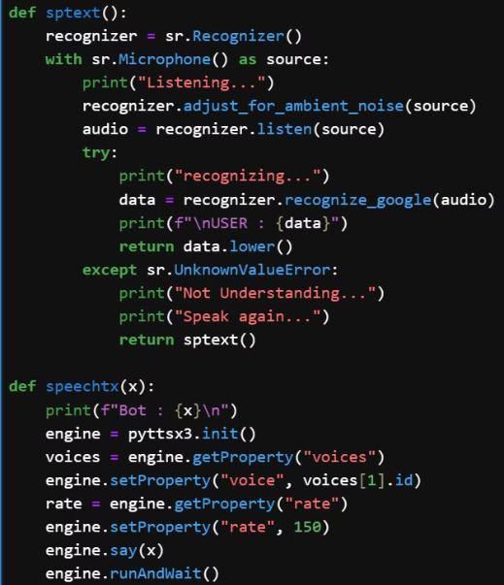

Listening and recognising part of the project

Slide 6
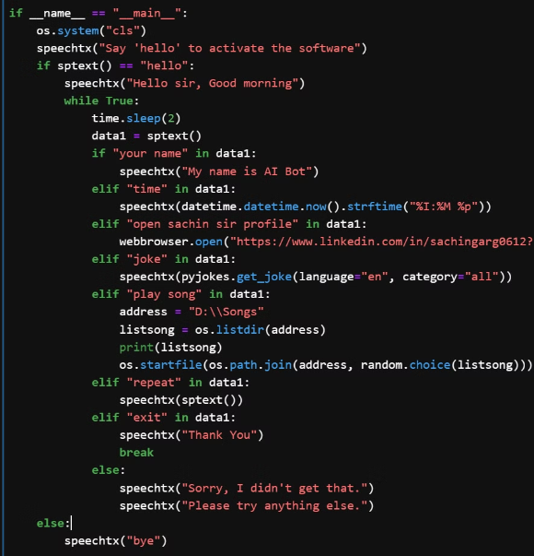

Main part of the code the processing part

Slide 7

Advantages of this Technology
1
Hands-free Control
2
Increased Accessibility
Users can operate devices without the need for manual input.
Voice recognition helps those with physical disabilities or limited mobility.
3
Improved Productivity
4
Natural Interaction
Voice commands can streamline workflows and minimize errors.
Conversational interfaces feel more intuitive and user-friendly.

Slide 8

Challenges and Limitations this system
Accuracy Limitations
Privacy Concerns
Voice recognition systems may struggle with accents, background noise, and complex language.
Users may be hesitant to share sensitive information through voice commands.
Hardware Dependence
User Adaptation
Reliable voice recognition requires high-quality microphones and processing power.
Users may need to adjust their speaking style to work effectively with the system.

Slide 9





Applications of virtual assistant Systems
Mobile Devices
Smart Home Automation
Accessibility Solutions
Customer Service
Voice commands for tasks like making calls, sending messages, and setting reminders.
Controlling connected devices like lights, thermostats, and security systems.
Enabling hands-free interaction for users with physical disabilities.
Automated voice-based solutions for handling inquiries and support requests.

Slide 10


Thank You
"Feeling gratitude and not expressing it is like wrapping a present and not giving it." - William Arthur Ward

